Slide 1


A wind tunnel for kids…
Status Update
February 16, 2012

Slide 2
Activities this week
Hardware work
Arduino communication experiments
Arduino development
Server library investigations
Android development
Totally awesome UI work
Project design discussions/documentation

Slide 3
Baseline Documentation Metrics
Metric | Value | Notes
# Developer Documents | 5 | SoW, SDP, SRS, SDD, Fall FQT
# Administrator Documents | 0
# Pages | 47
# Status Presentation Slides | 101

Slide 4
Baseline Code Metrics
Metric | Value | Notes
SLOC (Physical) | 9574
SLOC (Logical) | 7025
# Source Files | 107 | File types included: .h, .cpp, .java, .xml, .pde, .ino

Slide 5
Baseline Hardware Metrics
Metric | Value | Notes
# Sensors Prototyped | 3 | Temperature, Humidity, Hall Effect
# Control Elements Prototyped | 1 | Motor Control
# Sensors Integrated | 1 | Hall Effect
# Control Elements Integrated | 1 | Motor Control

Slide 6
Aurdino communication interface
http://youtu.be/UpoyA9MbZx0
Remotely controlling a light attached to an Arduino microcontroller via a webbrowser
Video also shows automatic power reset capability of the router, Ardunio board, and Ethernet shield
Next step: integrate with Android and real sensors, controllers

Slide 7
Significant Android UI updates
http://youtu.be/ZqCDj0iIIuw
Shows new splash screen, then
Selecting physical or virtual tunnel UI, then
Automatic UI generation based on “tag” concept where tags are an abstraction of the set of sensors and controllers we handle
More on this next week
Next step: complete connection between the Android UI and the Physical Tunnel’s sensors and controllers

Slide 8

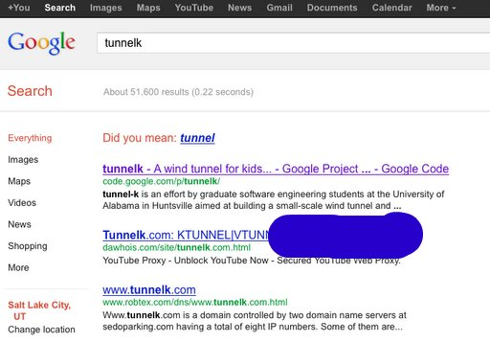

We are the top hit on Google!
@TunnelK
Notes:
Initial social network of choice…

